Slide 1

The Good Acre:
FINANCE HACKS
Matthew Burandt, Stephen Epstein, Norah Lu, Manideep Cherukuri, Meejoo Choi
Going from good to great with data analysis
Notes:
We are so excited to share our analysis with you on
How we can boost business efficiency of The Good Acre and maximi

Slide 2

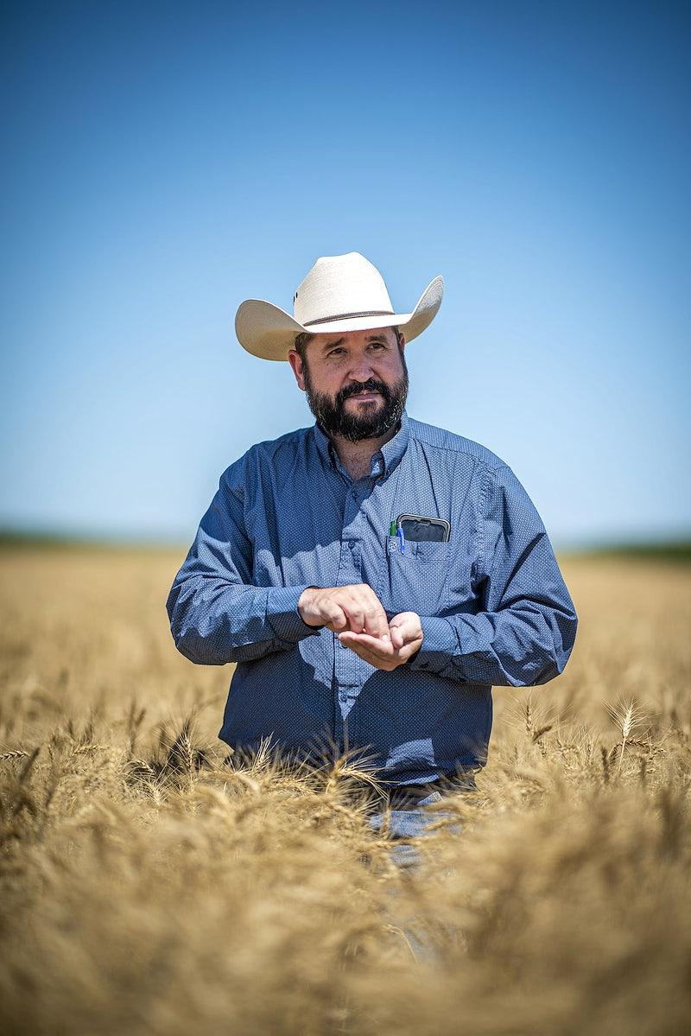
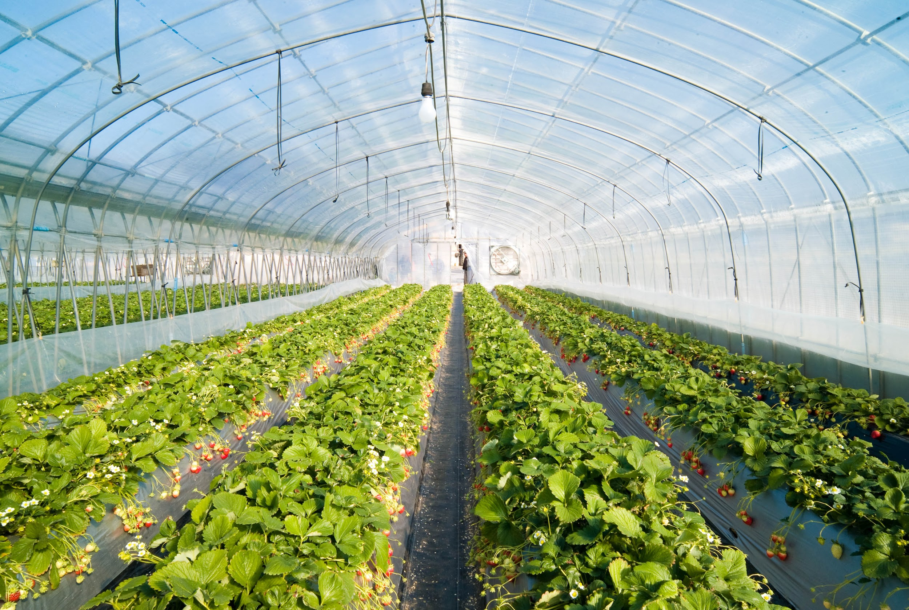
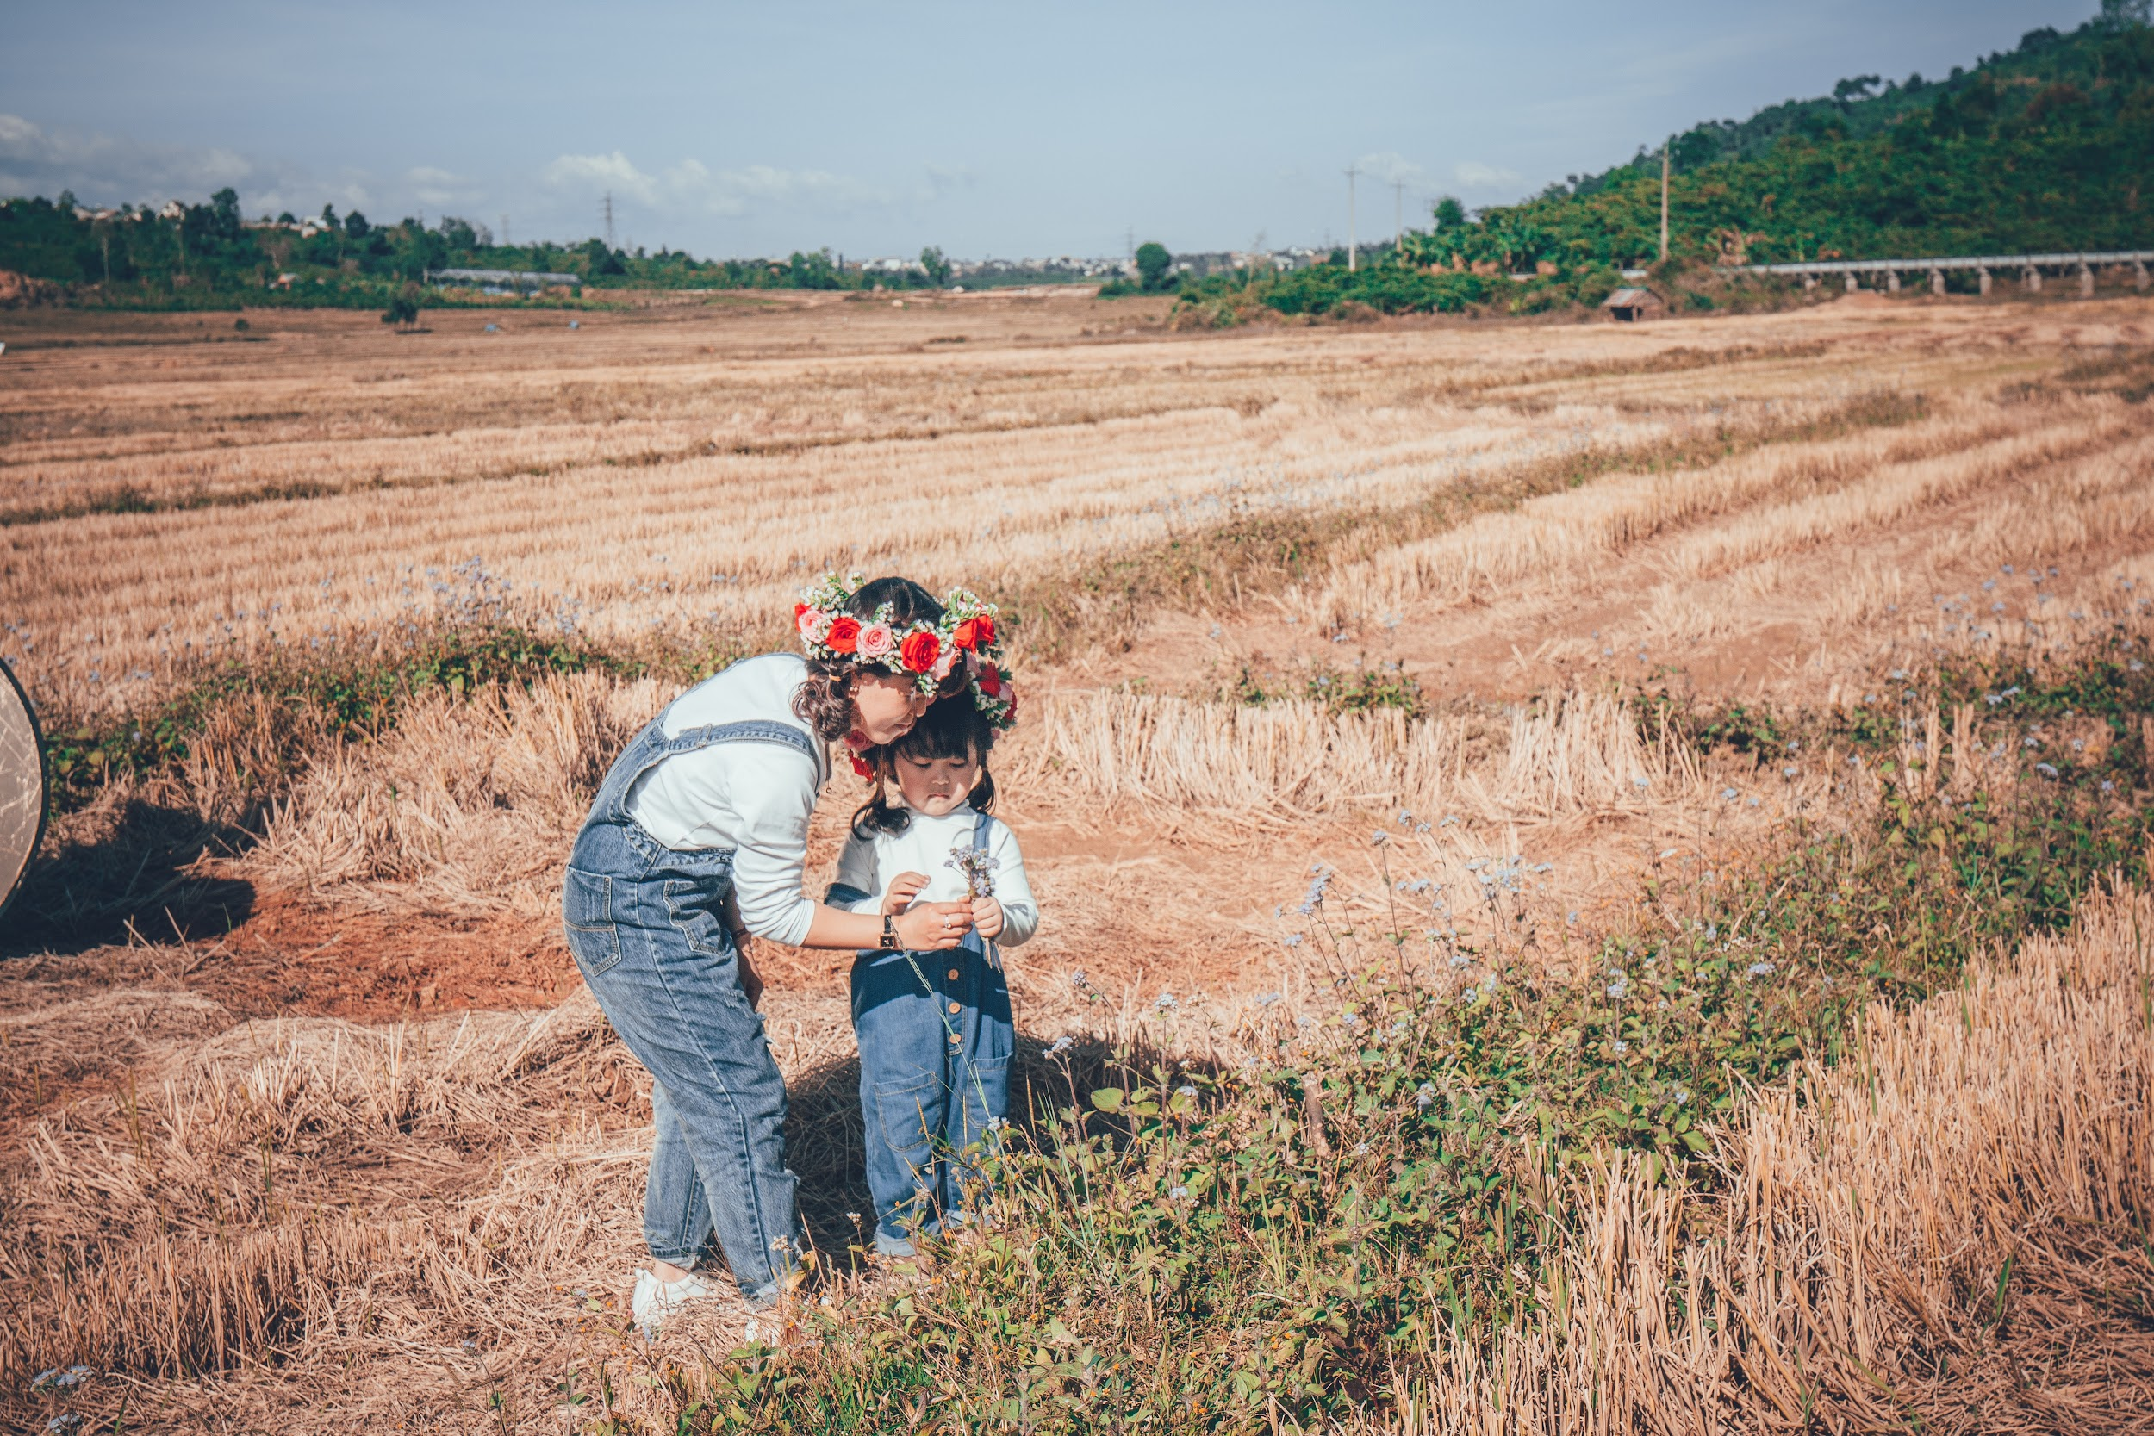
Agenda
The Good Vision
Problems
Solutions
Data Integrity
FarmScore Solution
FarmAid Solution
Description
Flow Chart
Timeline

Slide 3
The Good Vision
Maximize Efficiency Between Transaction
Support
Small Farmers
Rescue
the Food Waste

Slide 4
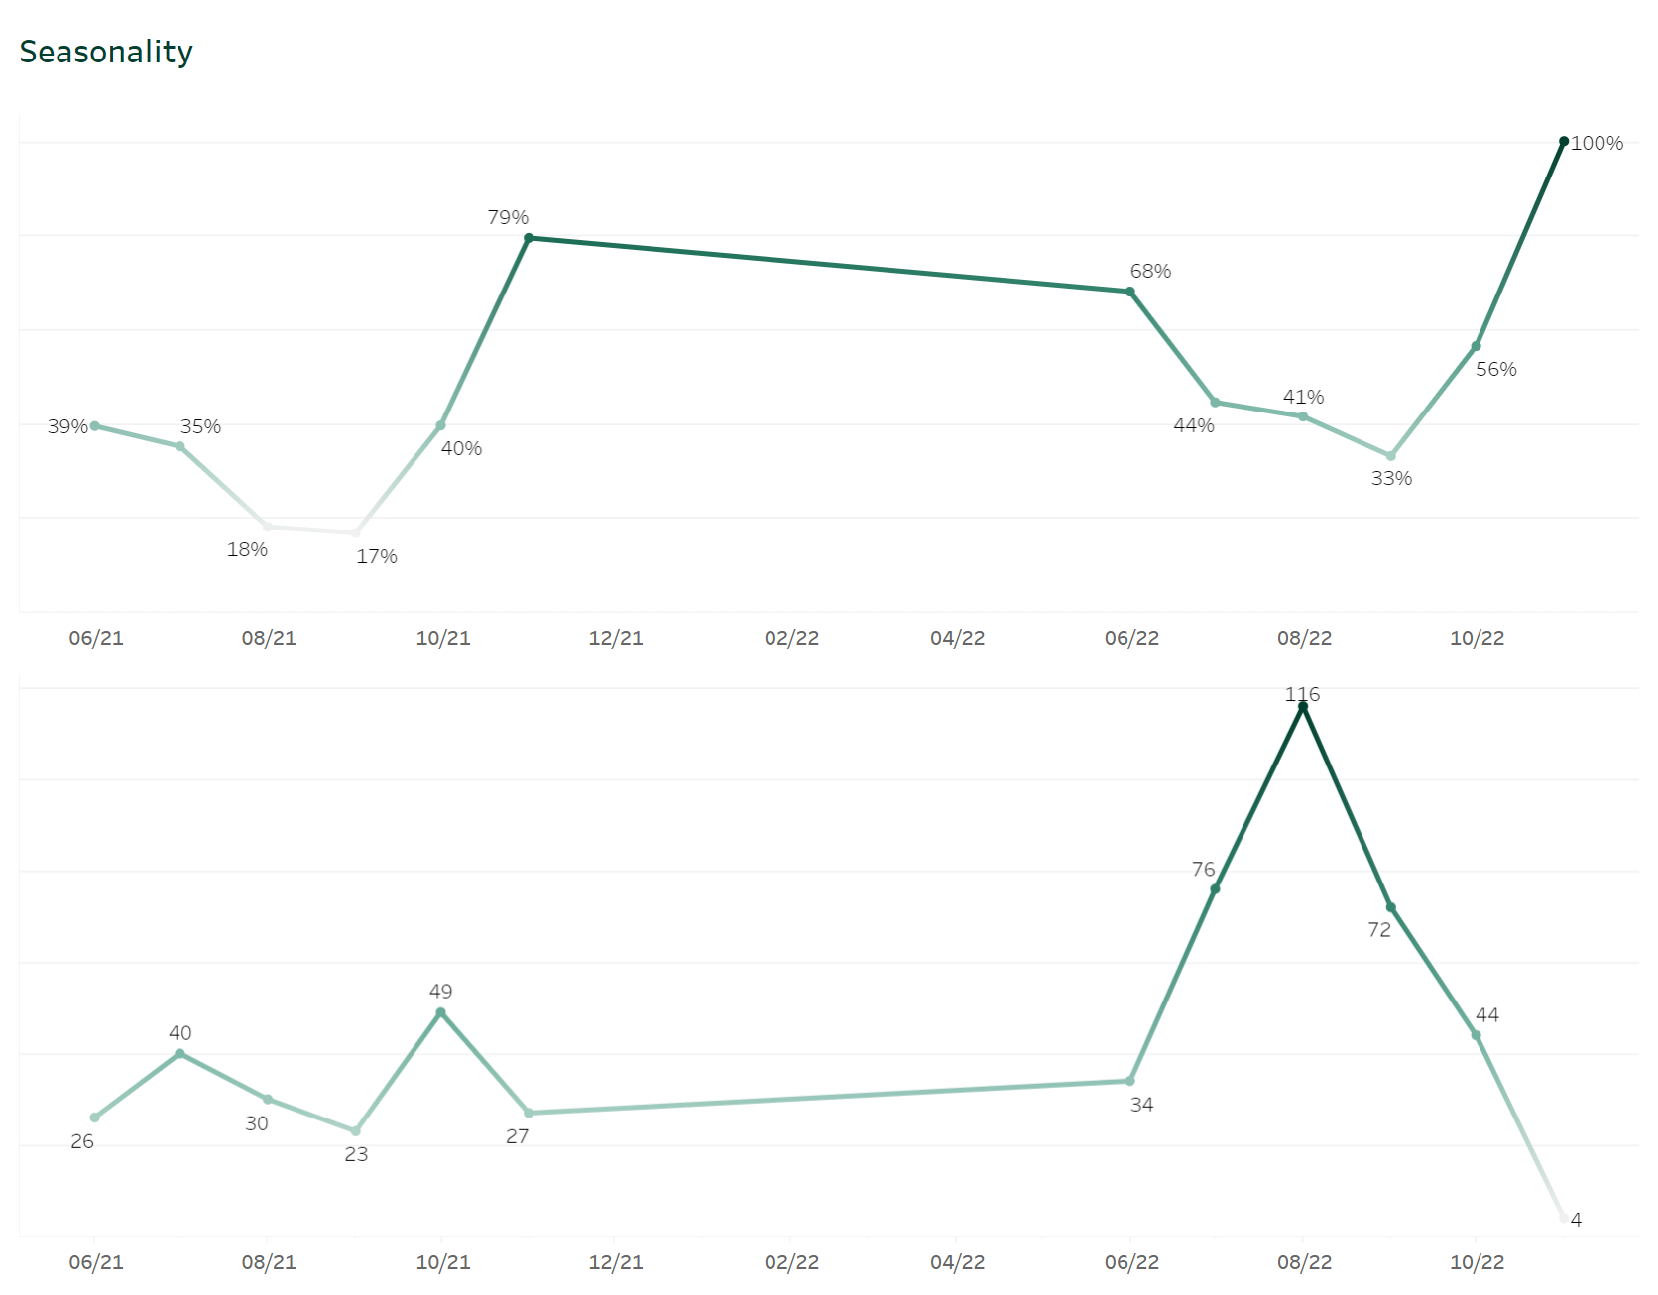
Problems: Undeliverables
Ratio of Undelivered Orders By Month
Undelivered Orders by Month
https://public.tableau.com/app/profile/nalian.lu/viz/Seasonality_16755293310650/Dashboard1?publish=yes
Notes:
For example, if the probability of delivery is 90%, the planning factor would be 1/0.9 = 1.11.
So if we need 100 units of yield, to compensate for the uncertainty, we can order 111 units to account for the possibility of the under deliveries.

Slide 5
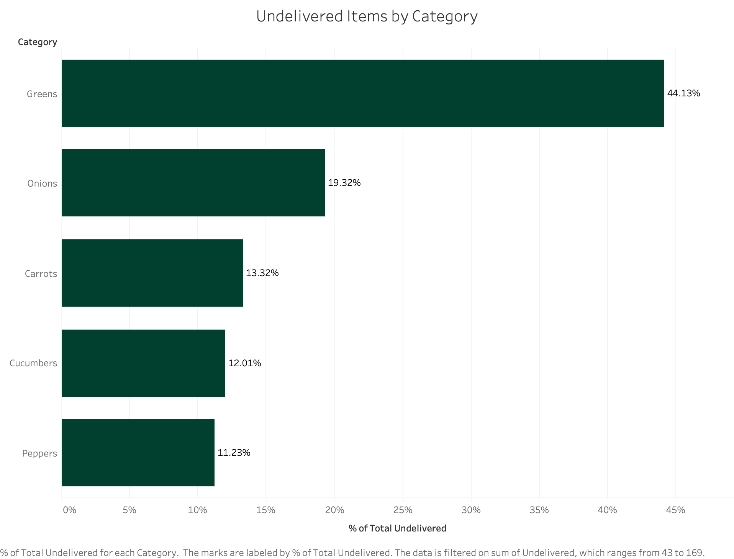
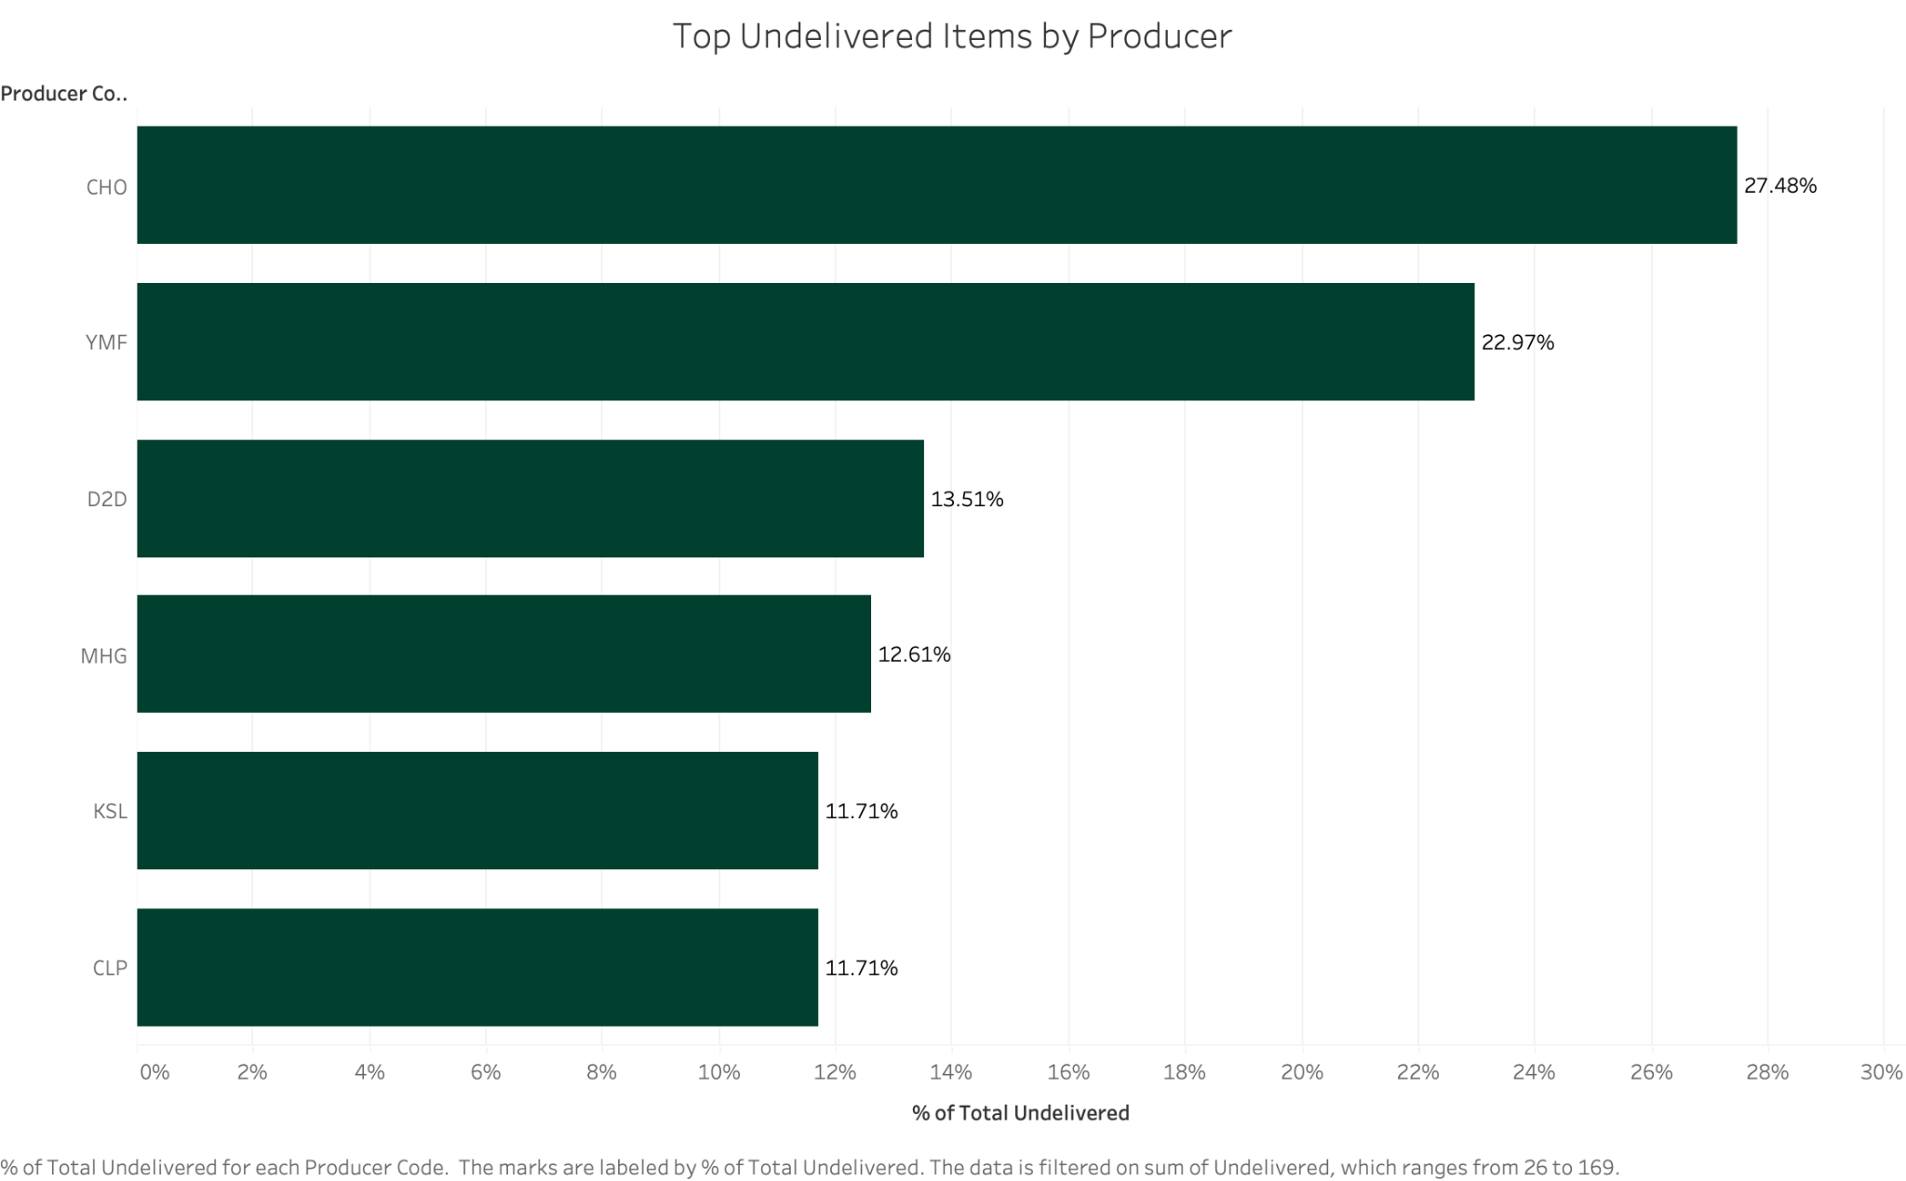
Problems: Undeliverables
14% of all planned orders go undelivered
3.5K cases of produce sales missed out on (Estimated $150K left on the table)
Greens
CHO

Slide 6
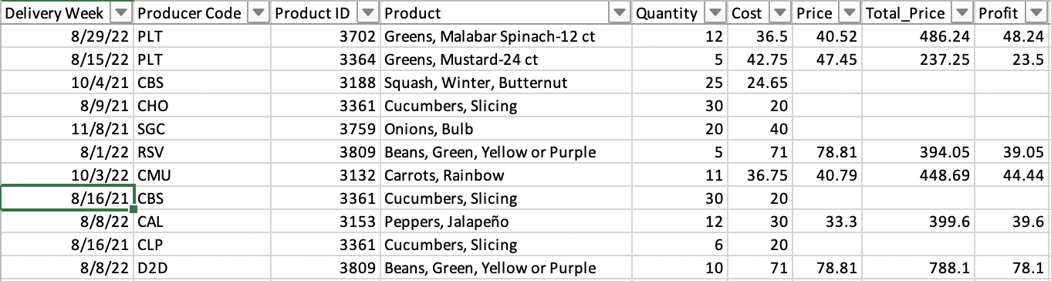
Problems: Poor Data Quality
Current data
Price data missing
Product Field should be separated
Product ID not useful unique identifier

Slide 7
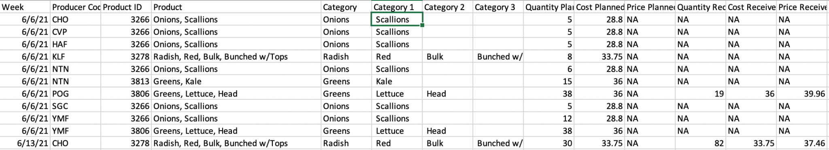
Solution 1: Improve Data Integrity
Current data
Price data missing
Product Field should be separated
Product ID not useful unique identifier
New data
New Category & Subcategory Fields
Merged Planned and Actual Files
Create an Order_ID system

Slide 8


Solution 2: FarmScore Scoring System
FarmScore
Tier A
A system to track producer reliability.
Percentage given to each producer.
Useful to identify more/less reliable producers.
90%
Tier B
85%
Tier C
70%
# of actual orders delivered
Probability of a successful Delivery (P)
FarmScore (in %)
# of planned orders
Planning Factor
1
P
Notes:
For example, if the probability of delivery is 90%, the planning factor would be 1/0.9 = 1.11.
So if we need 100 units of yield, to compensate for the uncertainty, we can order 111 units to account for the possibility of the under deliveries.

Slide 9
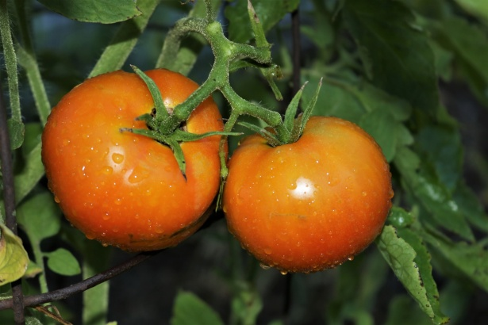

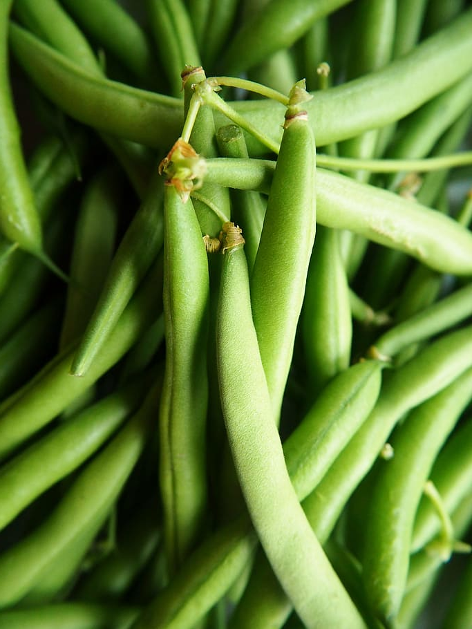
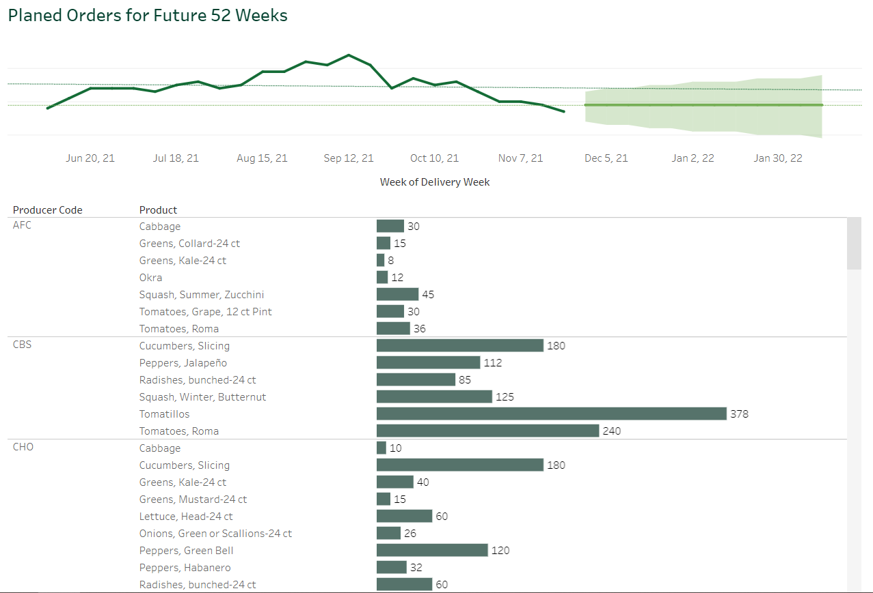
Solution 3: FarmAid Platform
Future Prediction
Dashboard generated by Tableau
Alarm System
Based on how many producers produce that food this month
Auto-send email through Macro
Organizational Benefits
Planning and visualizing the data
Dynamic supply and demand planning
Customer Benefits
Easier format for farmers to use
Past History
https://public.tableau.com/app/profile/nalian.lu/viz/DashboardforProducers/Dashboard1?publish=yes

Slide 10



FarmAid Flow
Email Alert
Farmer 1
Customer 1
Farmer 2
Customer 2
Farmer 3
Customer 3
Notes:
We envision this being a tableau-based system where farmers input their output levels.
This is how the FarmAid system will work, farmers will input date directly.
The inputs will be managed such that the data will be consistent and maintain good data cleansing principles we have already brought forth.
This system will help the good acre, who will also be able to write data into the system which they collect from the customers.
Since the customers of the Good Acre are more varied in type, we feel it is best for the Good Acre to input that data in.

Slide 11
Timeline
Today
Year 1
Year 2
Year 3
Data Integrity
(3+months ~ continuous
FarmScore
FarmAid
Notes:
In the first year, we strongly recommend implementing data integrity guidelines. This is the first step that fuels the rest of the steps.
In the next year, we recommend implementing the FarmScore system to identify the best performing producers. This helps The Good Acre make data-informed decisions.
Then, in year 3, we recommend building out the FarmAid system in Tableau.

Slide 12
Thank You

Slide 13
Appendix

Slide 14
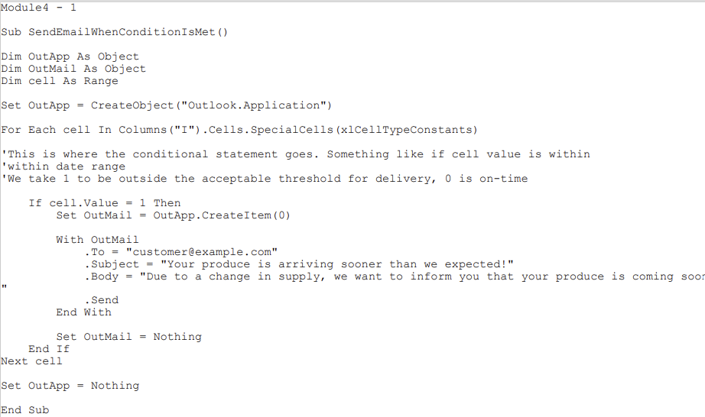
Appendix a. Email Alerts
Insert the customer’s email address
We recommend using a reference to a customer information database to dynamically change the email address. Using the customer_ID to get the email address.
Here put in the subject of the email.
We recommend keeping this generic so the potential for errors is minimal. You might also want to put in any brand flair.
Put the body of the email message in the quotes. Ideally, you should include the current estimated delivery window, calculated from the excel spreadsheet we have created.
A similar excel spreadsheet should be used going forward to manage this process.

Slide 15
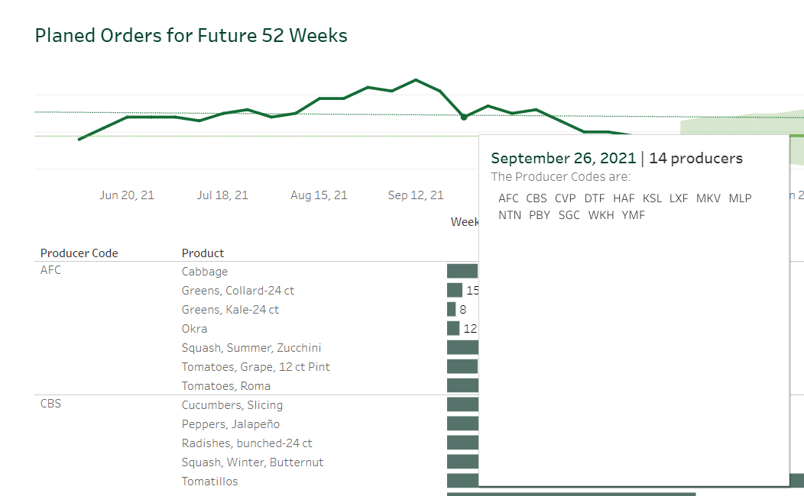
Appendix b. FarmAid Dashboard

Slide 16
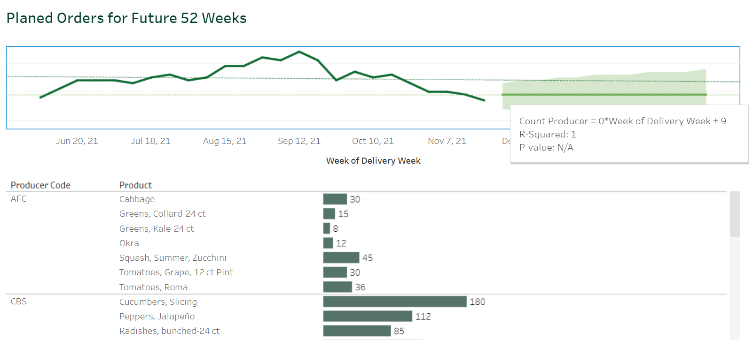
Appendix c. FarmAid Dashboard: Future Prediction

Slide 17
resource

Slide 18



#01402E
#56736B
#01401C

Slide 19
Farm management plan infographics
75%
50%
15%
Venus
Mercury
Mars
Venus is the second planet from the Sun and is terribly hot
It’s the closest planet to the Sun and the smallest of them all
Despite being red, Mars is actually a very cold place

Slide 20
Farm management plan infographics
Mercury
90%
Mars
50%
It’s the closest planet to the Sun
Mars is actually a very cold place
Venus
75%
Jupiter
40%
Venus has a very beautiful name
It’s the biggest planet of them all

Slide 21
Farm management plan infographics
Mars
Jupiter
Despite being red, Mars is a cold place
It’s the biggest planet in the Solar System
Venus
Mercury
Venus is the second planet from the Sun
Mercury is the closest planet to the Sun

Slide 22
Farm management plan infographics
About us
Venus
Mercury
Mars
Venus is the second planet from the Sun and is terribly hot
It’s the closest planet to the Sun and the smallest of them all
Despite being red, Mars is actually a very cold place

